Slide 1
GREEN CARD CIDB & ISO 45001: 2018 – DOCUMENT NEEDS FROM HR

Slide 2
1a) REQUIREMENTS DOCUMENT NEEDS FROM HR TO APPLY CIDB GREEN CARD FOR NEW Employee
FULL NAME -
I/C NUMBER - TO CHECK WHETHER THEY HAVE REGISTERED FOR CIDB GREEN CARD OR NOT
PHONE NUMBER - TO ENSURE THEY ARE READY OR NOT TO ATTEND THE CIDB GREEN CARD COURSE
POSITION - TO MAKE SURE THAT THEIR ENTITLED TO REGISTER FOR CIDB GREEN CARD OR NOT

Slide 3
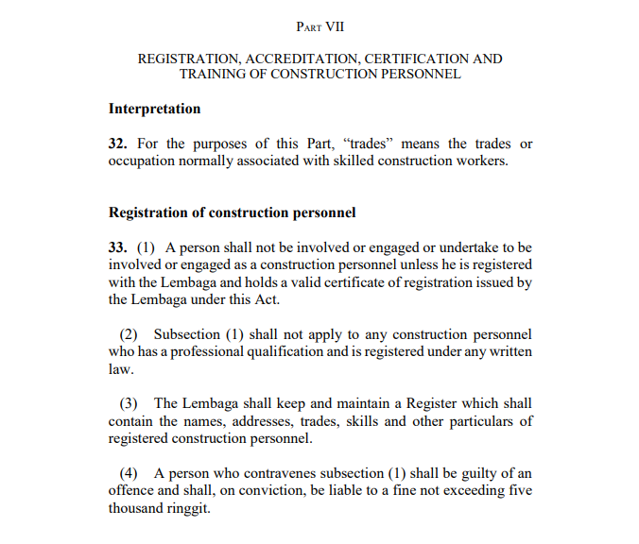
1b) purposes OF GREEN CARD
CIDB COMPLIANCE (LAWS) – Lembaga Pembangunan Industri Pembinaan Malaysia Act 1994 (Act 520)
IPO REQUIREMENT
ISO 45001:2018 OHS MANAGEMENT SYSTEM
IF NEW STAFF NEVER HAVE CIDB GREEN CARD ASKING THEM TO ATTEND THE CIDB AWARENESS COURSE TO GET CIDB GREEN CARD

Slide 4
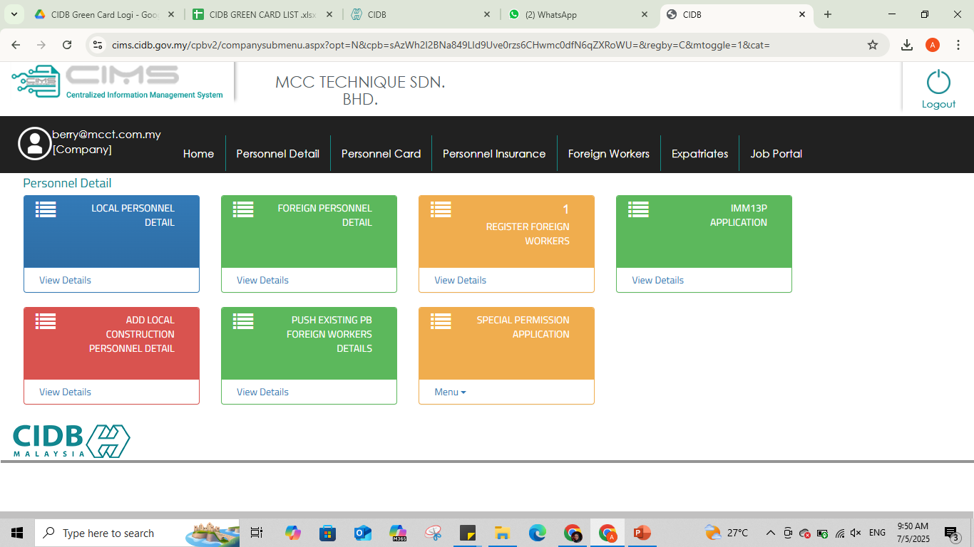
METHODS TO APPLY FOR A CIDB GREEN CARD COMPANY FOR NEW Employee
1. Click ‘view details’ at ‘Add Local Construction Personnel Detail’

Slide 5
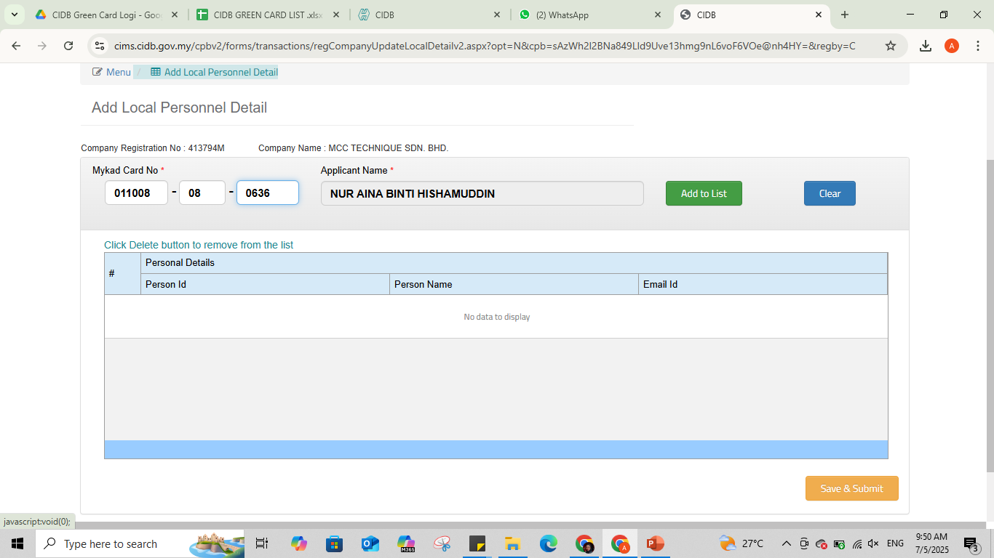
2. Insert the i/c number
3. Click ‘Add to List’

Slide 6
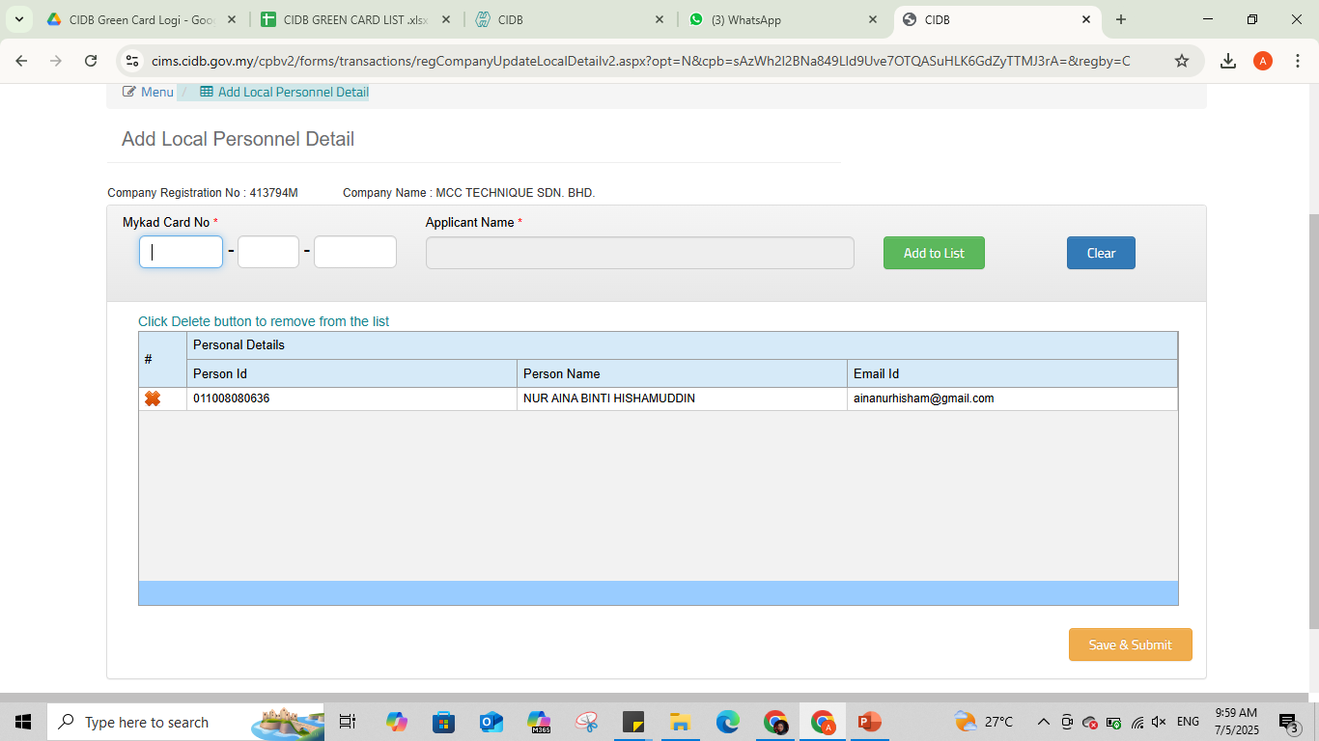
4. The name will appear here
5. Click ‘Save & Submit’ button

Slide 7
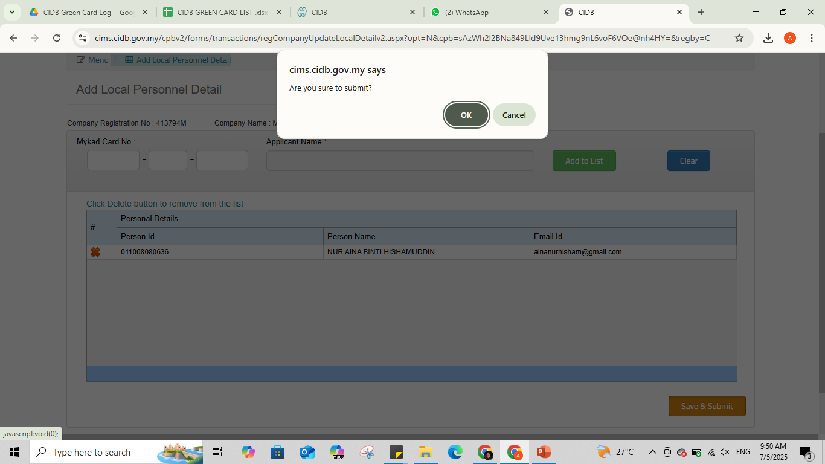
6. Click ‘OK’ to confirm submit

Slide 8
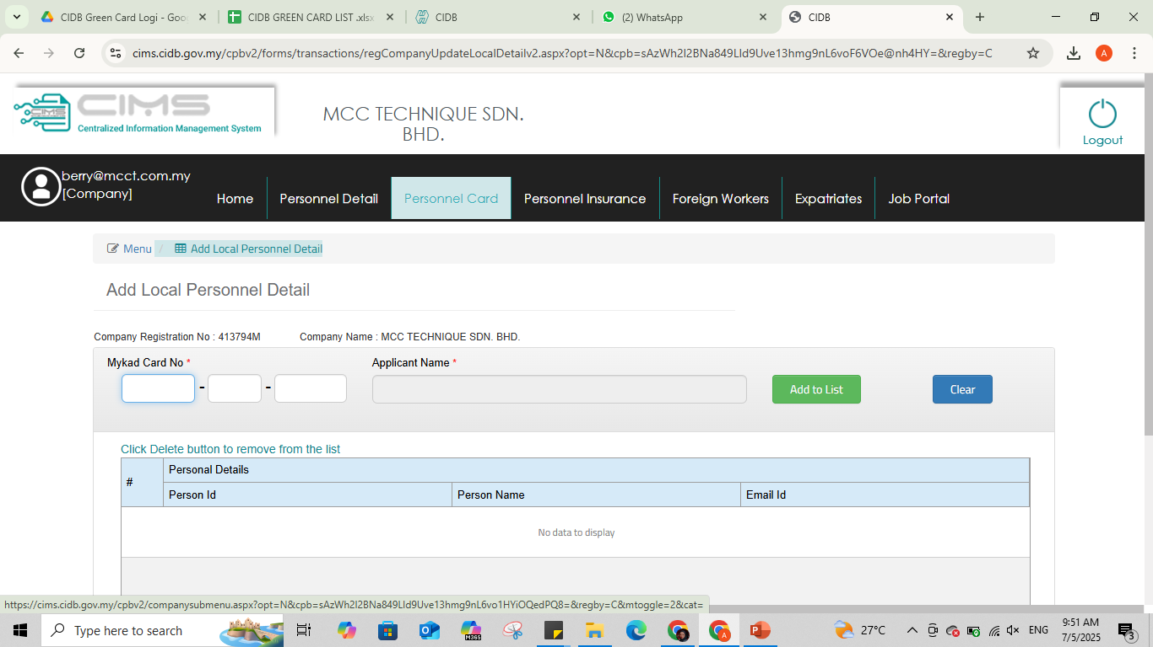
7. Click ‘Personnel Card’ button

Slide 9
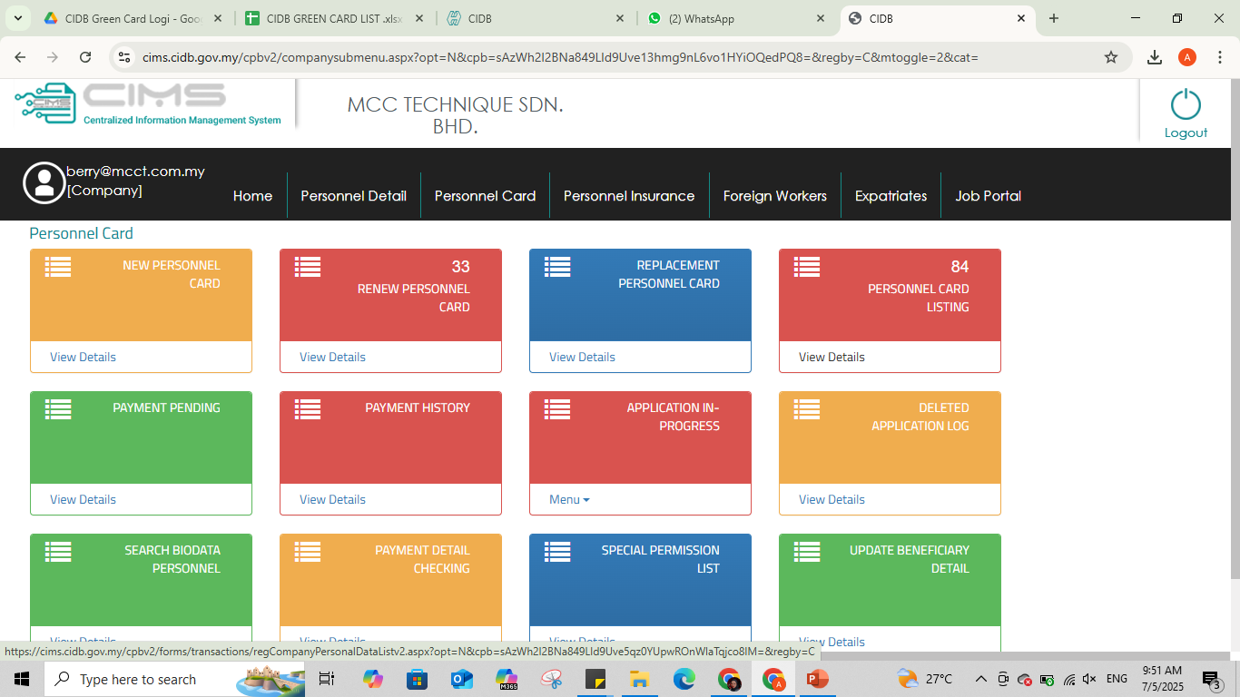
8. Click ‘view details’ at ‘Personnel Card Listing’

Slide 10
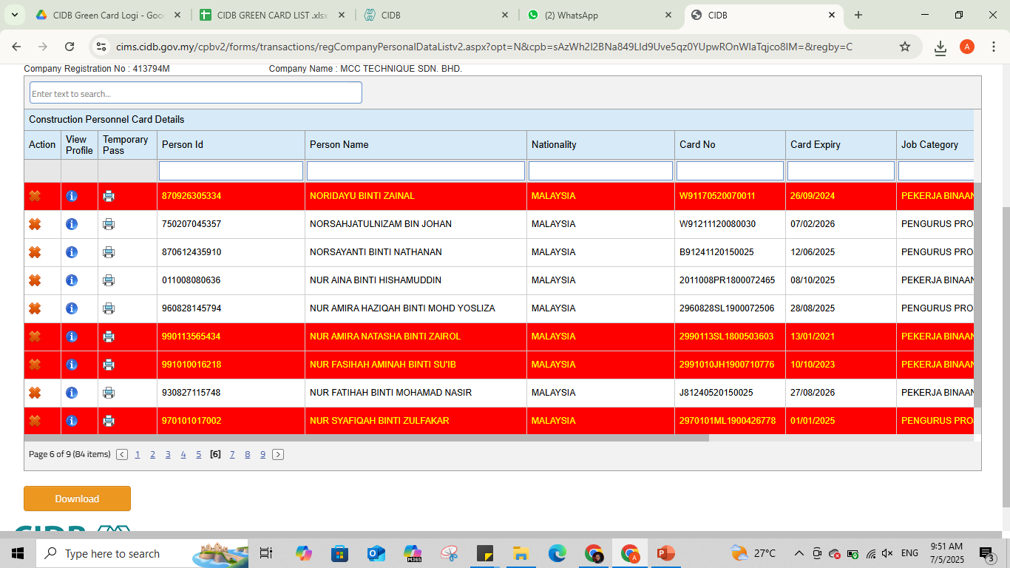
9. The name will appear here
10. Click ‘Download’

Slide 11
GREEN CARD FOR EXISTING STAFF/EMPLOYEE
MONITOR STAFF GREEN CARD EXPIRY DATES IN THE SYSTEM
RENEW EXPIRY GREEN CARD

Slide 12
REQUIREMENTS FOR LICENSE RENEWAL SPKK/PKK & SCORE (THE DOCUMENT WE NEED FROM HR)
I/C STAFF NUMBER*
SSM COMPANY
ACADEMIC CERTIFICATES *
COMPETENCY CERTIFICATES *
COMPANY AUTHORITY CERTIFICATE
FINANCIAL REPORT
AUDIT REPORT
TOTAL NUMBERS OF STAFF *
ATTENDANCE SOFTWARE (INFOTECH) *

Slide 13
ISO 45001 – DOCUMENTS WE NEED FROM HR
COMPETENCY CERTIFICATES / ACADEMIC CERTIFICATES
NUMBER OF WORKERS
CONTINUAL TRAINING CERTIFICATES (TRAINING BY OUTSOURCE) – EG: ACCREDITATION CIDB, DOSH,
TRAINING REQUIREMENTS (REQUEST BY SITE)
PPE RECORD (PROVIDE BY COMPANY) – EG: SAFETY HELMET, SAFETY SHOE, SAFETY VEST / RECEIPT OR TRACKING RECORD

