Slide 1

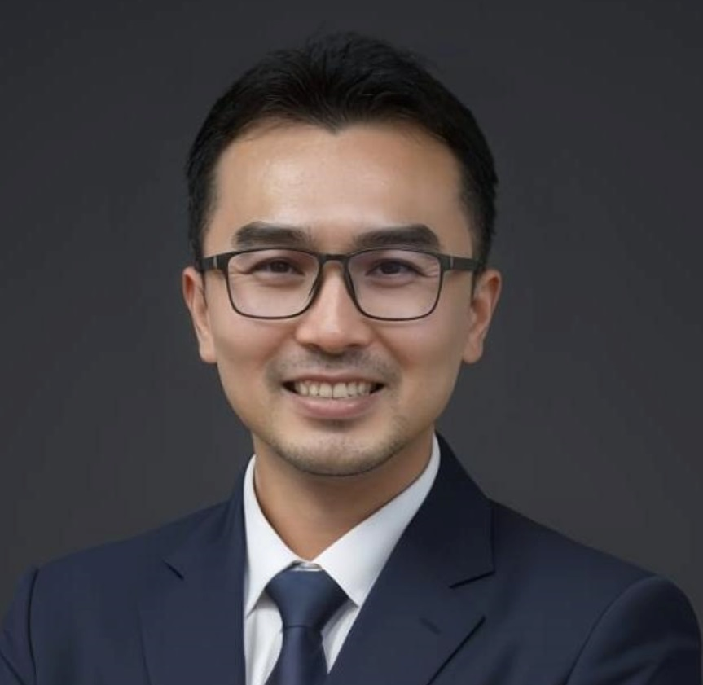
Safety awareness training iso 45001:2018
Mr. Mak

