Slide 1
Safety & Health Committee Meeting Agenda
Date: 09 September 2025
Attendees: SHO, SSS, Safety Coordinator
M&E Contractor Company

Slide 2
Meeting Agenda
1. Welcome & Opening Remarks
2. Review of Previous Meeting Minutes & Action Items
3. Safety Performance Review
• Incident Reports / Near Misses
• Site Inspection Findings
• Corrective & Preventive Actions
4. Legal & Regulatory Compliance Updates
5. Review of HIRAC (Hazard Identification, Risk Assessment & Control)
6. Training & Awareness Program
7. Emergency Preparedness & Response Updates
8. Employee Feedback & Participation
9. Any Other Business (AOB)
10. Summary of Action Items & Closing Remarks

Slide 3
Title: Safety Committee Meeting (Meeting Agenda)
Date: 09 September 2025
Time: 10.00am- 12.00pm
Venue: The Cruze Lot 12-(2nd Floor)
No. | Agenda meeting | Time | Remark
1 | Welcome & Attendance | 10.00am-10.15am
2 | Review Previous Minutes & action Item | 10.15am-10.45am
3 | Full body check-up claim-Process for competent person to renew license (act required?) with section to refer. | 10.45am-11.00am
4 | Appointment letter for safety committee | 11.00am-11.15am
5 | Training for competent certificate-(application process, bond requirement) (if any) | 11.15am-11.30am
6 | Iso implementation progress-review file and discuss compliance gaps | 11.30am-12.00pm
7 | Close meeting | 12.00pm

Slide 4
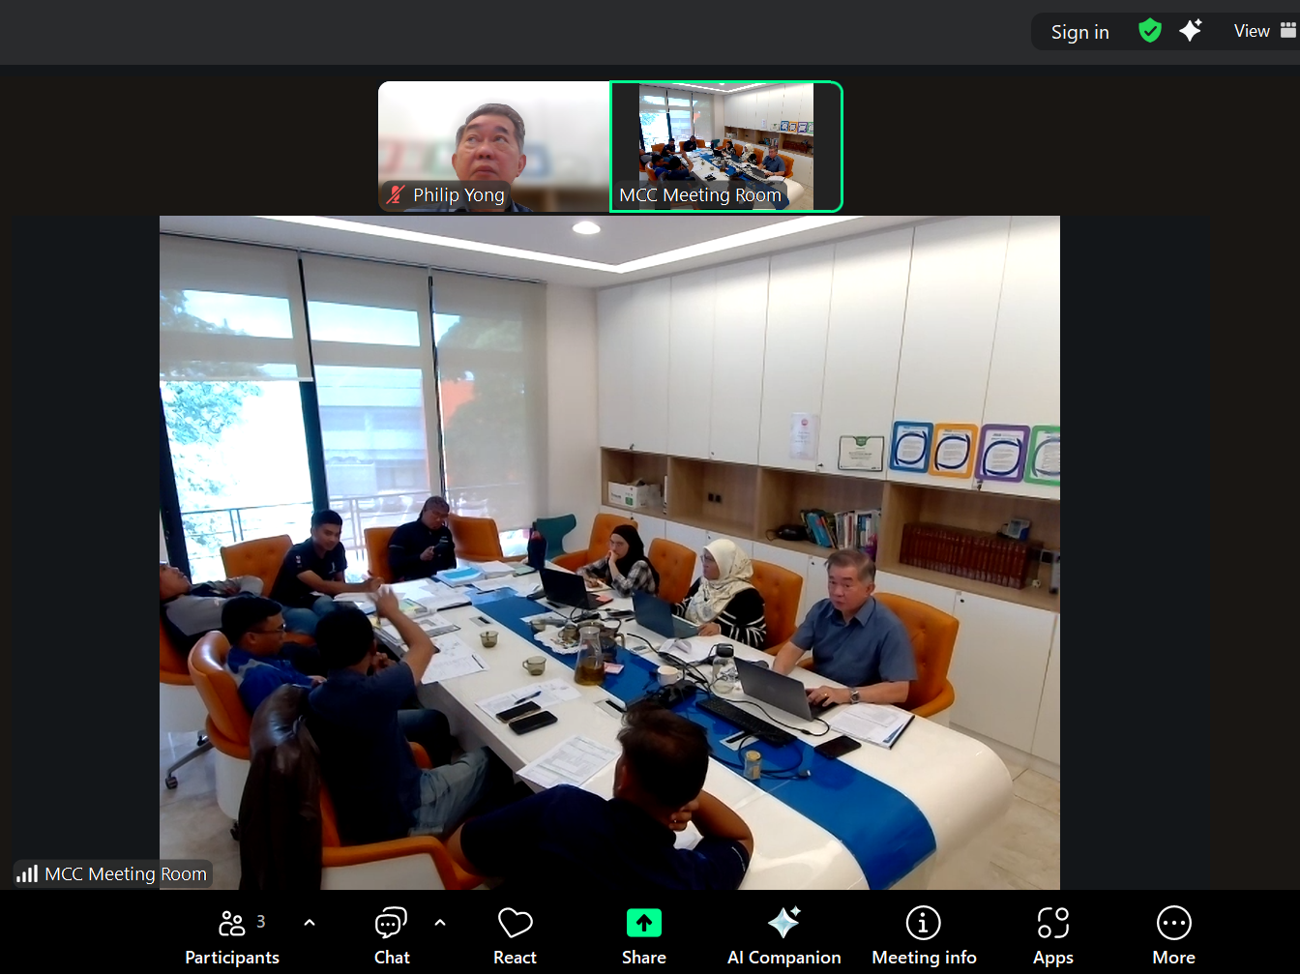

Slide 5


