Slide 1
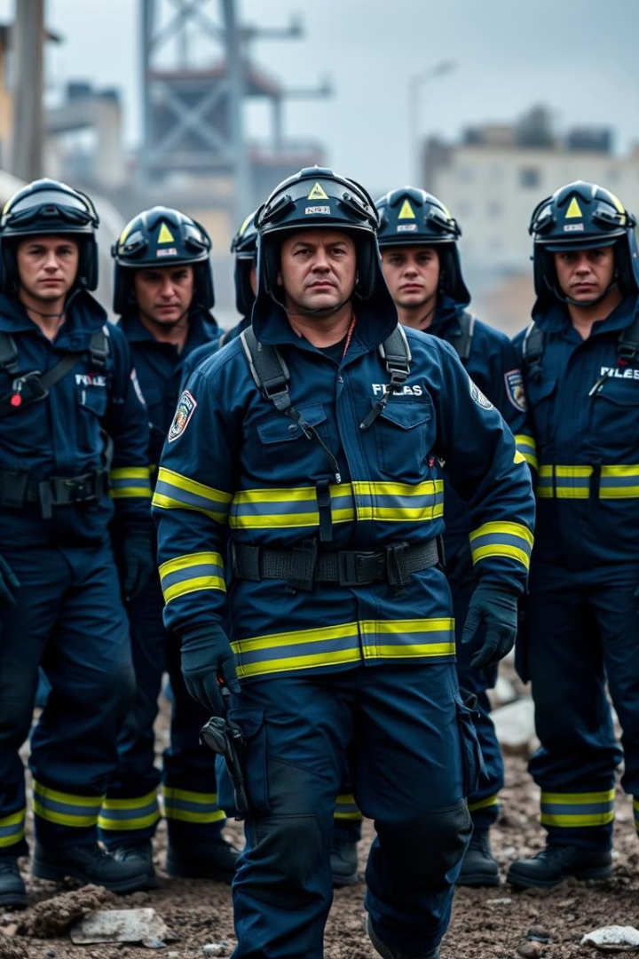
The Cruze: Emergency Response Team Duties & Responsibilities
Welcome to the presentation on Cruze Emergency Response Team roles. We will cover core duties, responsibilities, and best practices for effective response during crises.
by Philip Yong
PY

Slide 2

Incident Assessment & Initial Response
Rapid Situation Analysis
Establish Command
Quickly evaluate hazards and risks at the incident site.
Activate incident command structure for coordinated efforts.
Communicate Urgently
Notify relevant authorities and support teams immediately.

Slide 3
Search and Rescue Operations
Locate Victims
Safe Extraction
Provide Medical Aid
Use tools and trained skills to find trapped or injured people.
Prioritize victim safety when removing them from danger zones.
Deliver immediate first aid to stabilize casualties onsite.

Slide 4
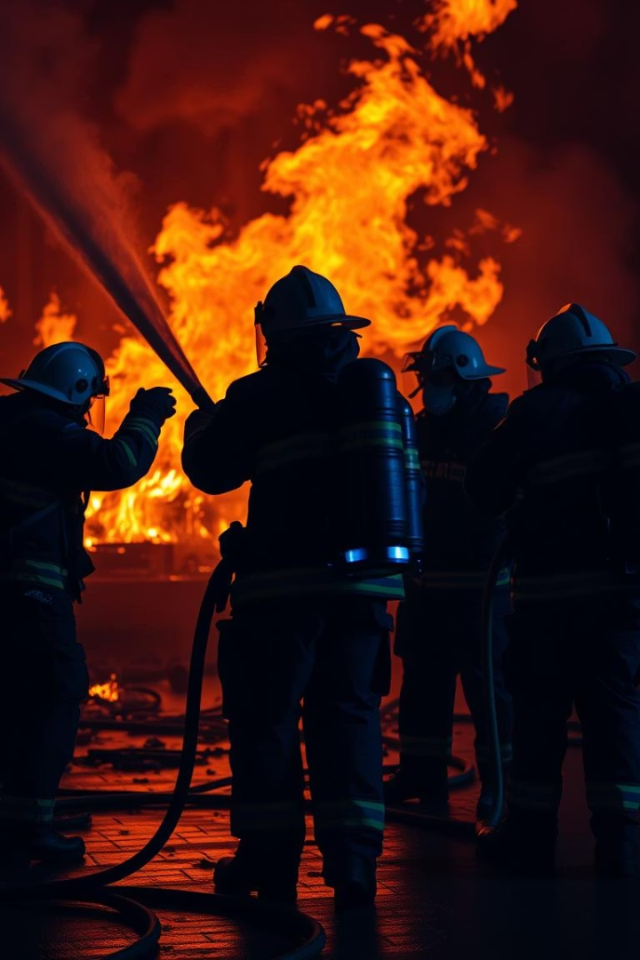
Fire Suppression & Hazard Control
Firefighting
Hazard Mitigation
Apply firefighting techniques to control and suppress fires.
Identify and isolate chemical, biological, or physical hazards.
Evacuation Assistance
Support safe evacuation procedures and routes for affected areas.

Slide 5
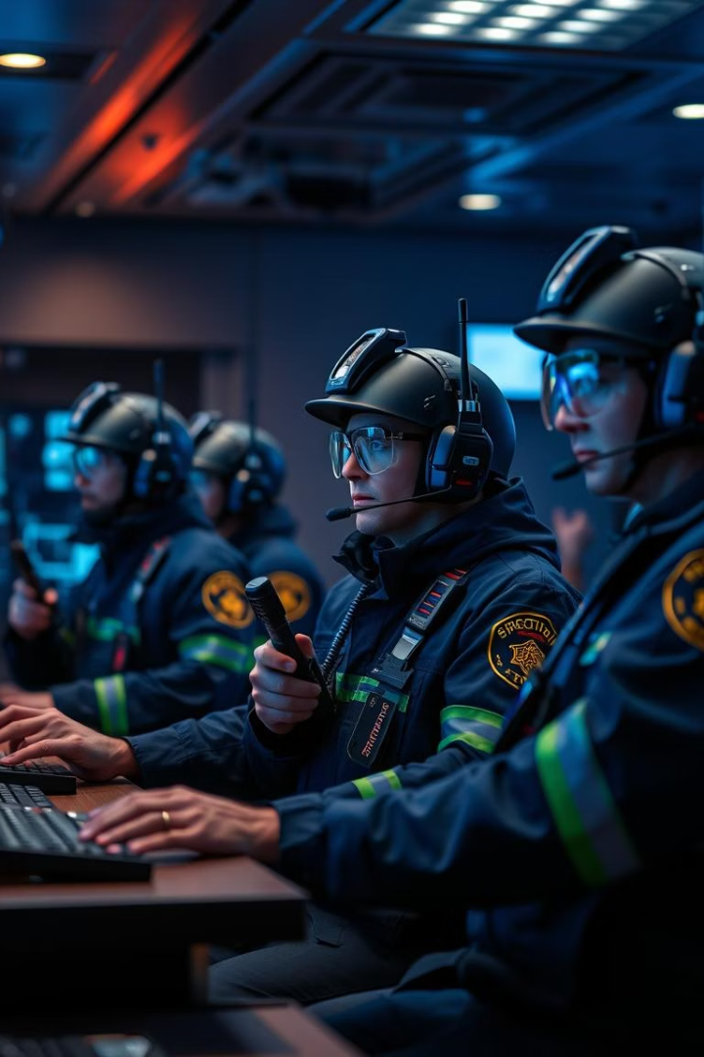



Communication & Coordination
Radio Communication
Maintain constant contact with field teams and command center.
Data Sharing
Use digital platforms to share updates and status reports.
Multi-agency Collaboration
Coordinate with law enforcement, medical, and fire departments.

Slide 6








Safety & Personal Protective Equipment (PPE)
Head Protection
Respiratory Safety
Wear certified helmets to prevent head injuries.
Use masks and respirators against smoke and toxic fumes.
Footwear
Hand Protection
Durable boots to protect against sharp or unstable surfaces.
Gloves to avoid cuts, burns, and contamination risks.

Slide 7
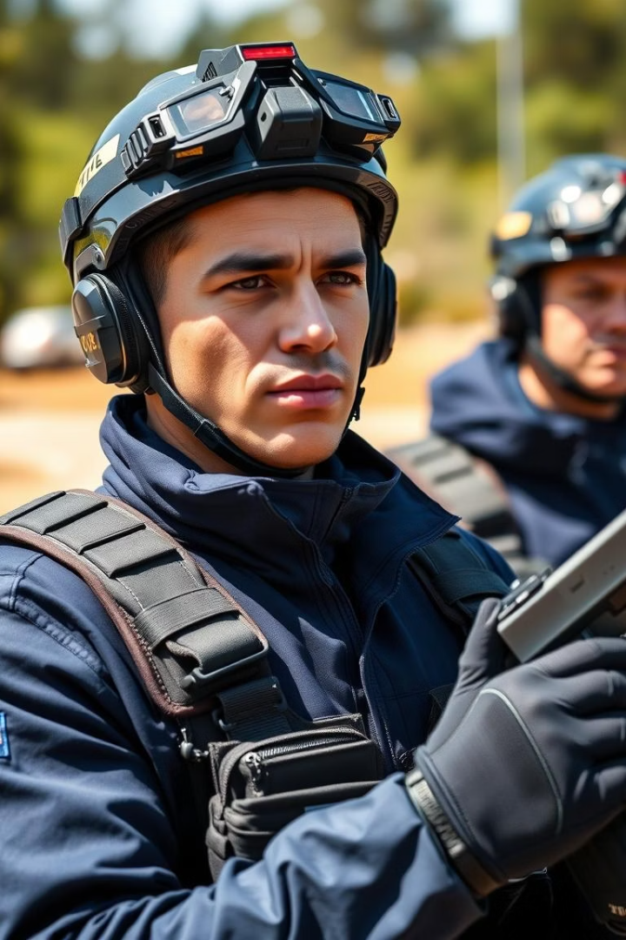
Training and Preparedness
Regular Drills
Conduct frequent emergency simulations to build readiness.
Skill Maintenance
Periodic refreshers on rescue, medical, and communication skills.
Equipment Checks
Routine inspection and maintenance of response tools and gear.

Slide 8
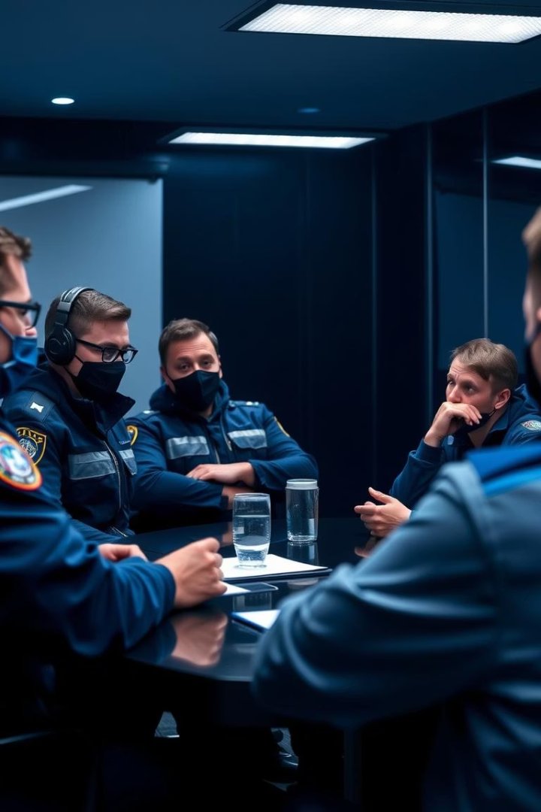




Key Takeaways & Next Steps
Understand Roles
Every team member must know their specific duties.
Prioritize Safety
Ensure all protective measures are followed during incidents.
Continuous Training
Regular practice enhances effectiveness in real emergencies.
Effective Communication
Clear and timely info-sharing saves lives and resources.

