Slide 1

Emergency Response Team Duties & Responsibilities
The Administration Department of Mcc Technique Sdn. Bhd. coordinates with all building occupants at The Cruze Lot 10 & 12 to ensure they are well-versed with the Emergency Response Plan (ERP) operations. This plan is regularly practiced to protect both people and assets during emergency situations.
The ERP defines 'Occupants' as all inhabitants (employees, vendors) and visitors in The Cruze building. 'Emergency Response Authorities (ERA)' refers to Police Force, Fire Brigade, Medical Units, Civil Rescue Squad, and Rela volunteers. The 'Emergency Response Team (ERT)' consists of floor wardens and appointed personnel under the ERP Commander's direction.
PY
by Philip Yong

Slide 2
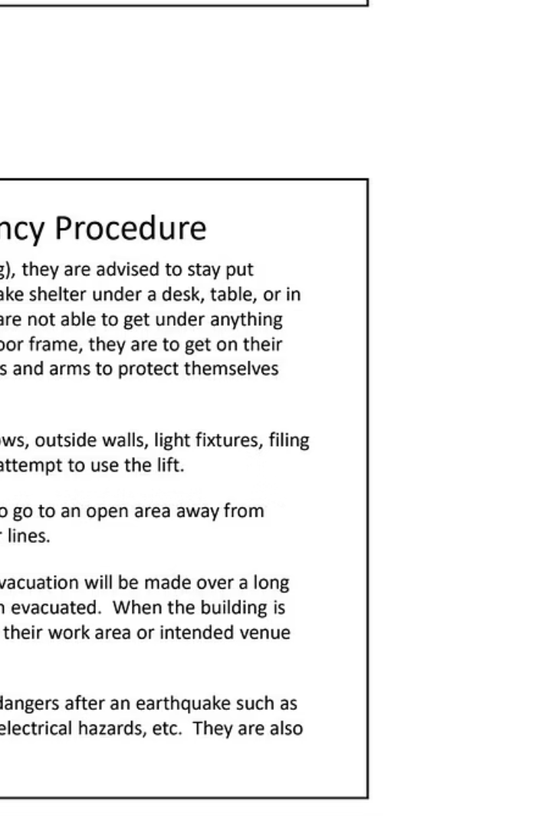



Bomb Threat Emergency Procedure
Immediate Notification
If a bomb threat is received or a suspicious object discovered, immediately notify the nearest Police Station or call 911, providing all necessary details about the threat, discovery time, and location.
Police Investigation
Any ERT member will report to the Police in charge and allow them to begin their investigation of the bomb threat. The evacuation decision will be determined by the Police Officer or ERT Commander.
Building Evacuation
If evacuation is required, the Police Officer or ERT Commander will sound a series of alarm bells using the building fire protection system. Occupants must not return to work areas until authorized.

Slide 3

Serious Injury Emergency Procedure
Assess the Situation
ERT members, ERA, and capable occupants should check for injured persons and assess their condition to determine danger potential and injury extent. Do not move seriously injured victims unless there's immediate danger like fire or poisonous gas.
Call for Help
Call Police at 911 immediately if any injured victim is found. Request an ambulance if the victim has breathing difficulties, chest pain, severe bleeding, slurred speech, poisoning, head/neck/back injuries, or possible broken bones.
Provide First Aid
Keep the victim calm and comfortable. Trained personnel should administer CPR or First Aid when necessary, taking precautions to minimize exposure to blood and bodily fluids. Stay with the victim until ERT or ERA arrives.

Slide 4
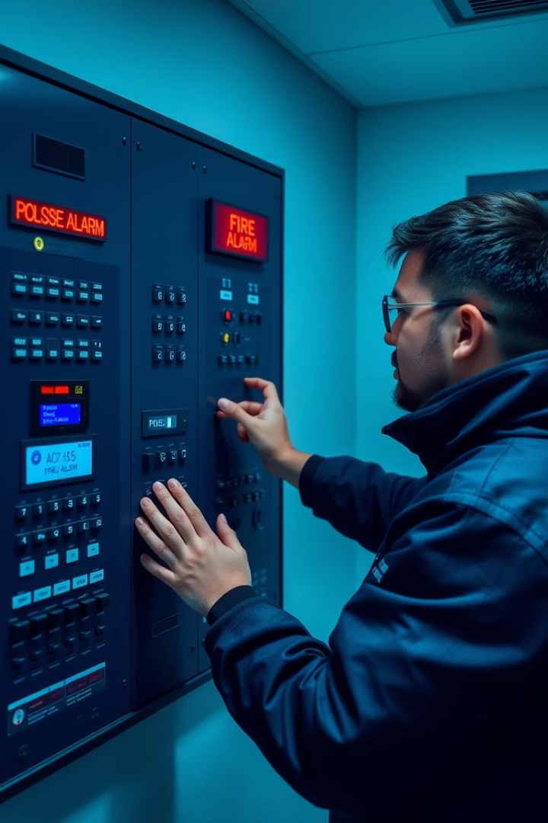



False Alarm Procedure
Investigation
Notification
If the fire alarm triggers, the ERT Commander will dispatch a team member to investigate the area indicated on the fire control panel to determine if it's a genuine emergency.
If the alarm was erroneously triggered, the ERT Commander or team member will isolate the fire control panel and make verbal/mobile announcements about the false alarm, calling back those who evacuated.
Documentation
An incident report regarding the false alarm will be lodged to the ERP Commander. Building maintenance personnel will be informed to check the fire control panel for any faults.

Slide 5
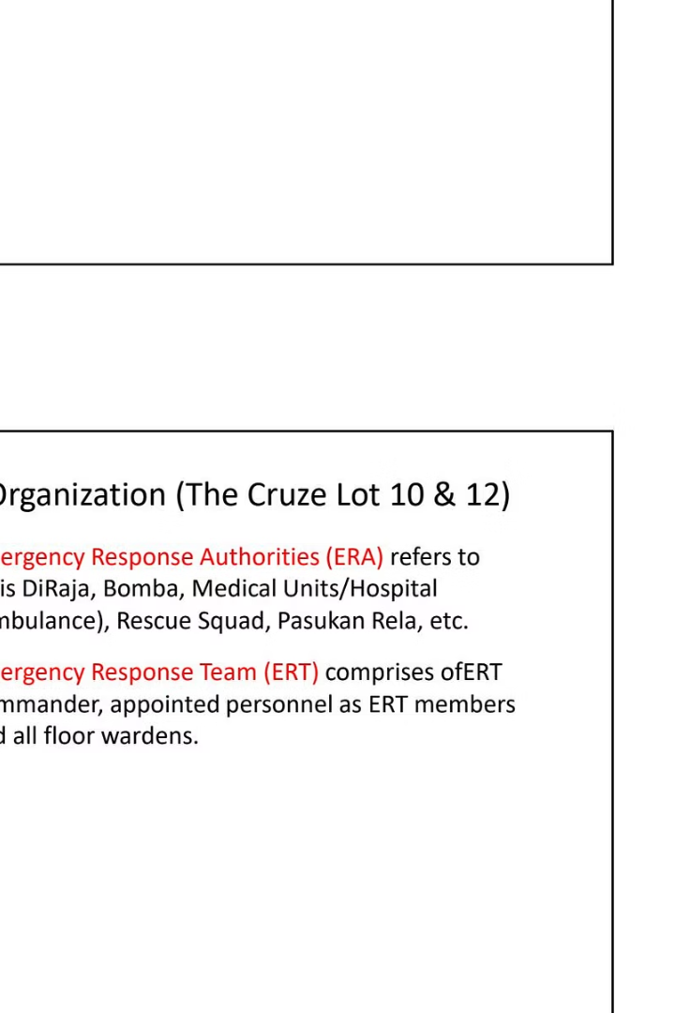
Emergency Call Centers & Commander
911
Police
For security emergencies and threats
911
Ambulance
For medical emergencies
911
Fire Brigade
For fire emergencies
016-6622021
ERT Commander
Philip Yong - Emergency Response Team Commander
These emergency contact numbers should be readily available to all building occupants. In any emergency situation, contacting the appropriate authorities quickly is essential for an effective response and to minimize potential harm or damage.

Slide 6
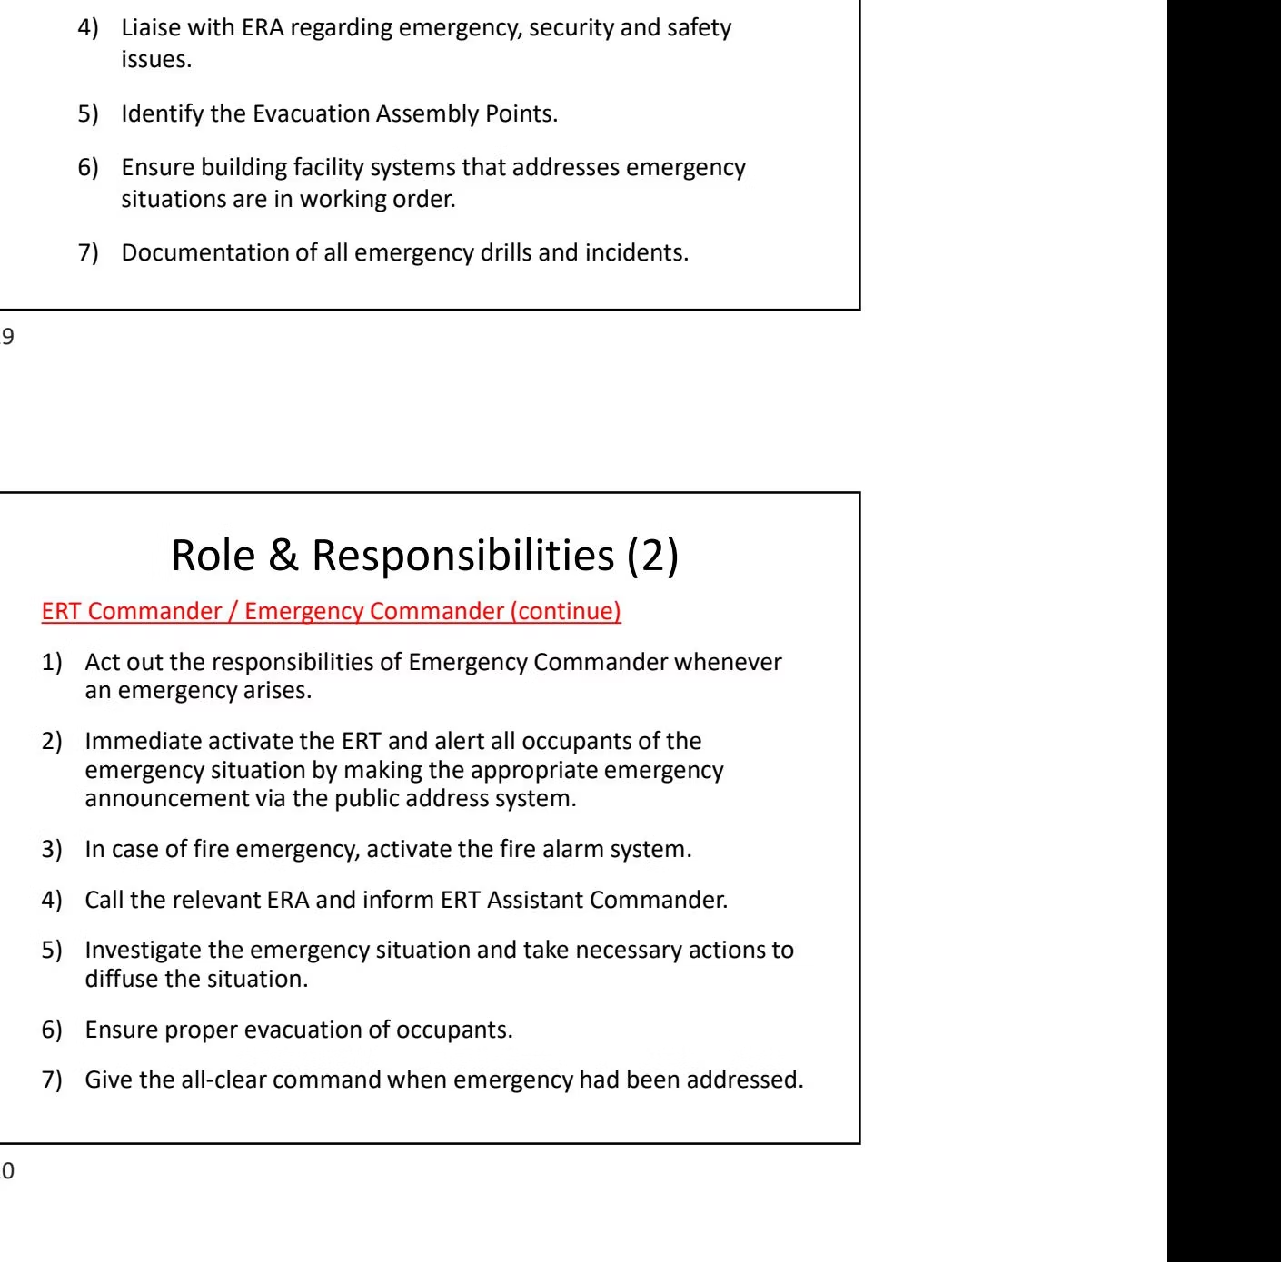




ERT Commander Responsibilities
Risk Assessment
Implementation
Conduct risk assessment on possible emergency incidents and formulate the ERP procedures
Implement the Emergency Response Plan and appoint/manage the ERT
Documentation
Coordination
Ensure documentation of all emergency drills and incidents
Liaise with Emergency Response Authorities regarding emergency, security, and safety issues
The ERT Commander also identifies Evacuation Assembly Points and ensures building facility systems that address emergency situations are in working order.

Slide 7

Floor Warden Responsibilities
Building Knowledge
Personnel Management
Evacuation Duties
Be familiar with fire alarm systems, entry/exit points, emergency staircases, alternative escape routes, floor layout, access control doors, and location of fire extinguishers and other firefighting equipment.
Know names and mobile numbers of all staff members on the floor, including details about disabled or mobility-impaired persons requiring assistance during evacuation.
Check all areas including toilets and conference rooms, assist visitors and disabled persons, move to Evacuation Assembly Point, take attendance, and report head count to the Emergency Commander.
Floor Wardens must also attend debriefing by the ERP Coordinator or Emergency Commander after the emergency situation has been called off.

Slide 8
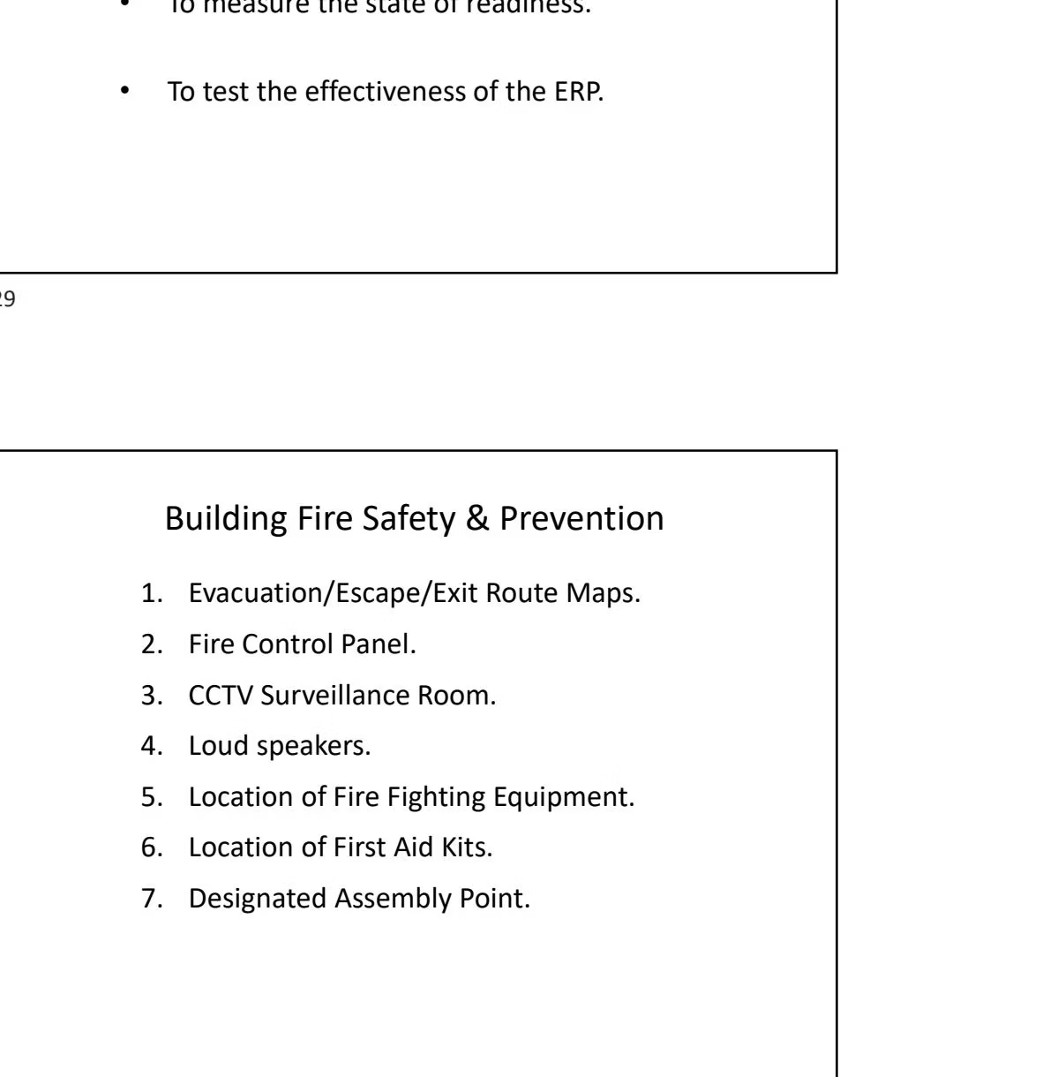

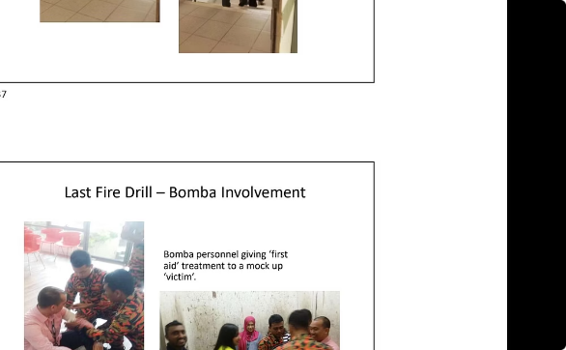
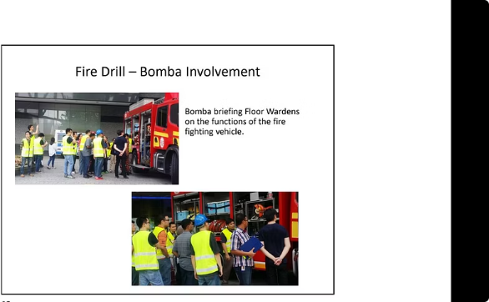
Purpose of Fire Drills
Safe Evacuation
Readiness Assessment
Plan Effectiveness
Fire drills ensure everyone in the building knows how to exit in the quickest, easiest, and safest way possible during emergencies like fire, smoke, or carbon monoxide incidents.
Regular drills help measure the state of readiness of the Emergency Response Team and building occupants, identifying areas for improvement.
Drills test the effectiveness of the Emergency Response Plan, allowing for adjustments and improvements to procedures before a real emergency occurs.

