Slide 1
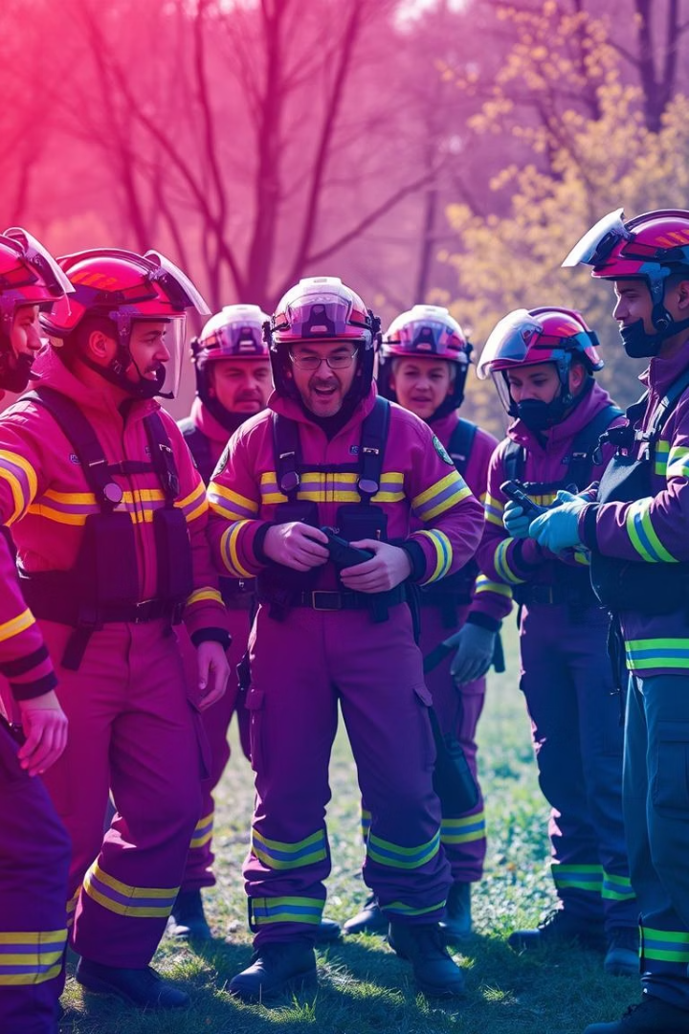
Emergency Response Team: Roles & Responsibilities
Protecting life, property, and environment during emergencies is the team's mission. Clear roles and responsibilities enable effective, coordinated responses. Training, preparedness, and collaboration ensure readiness for diverse incidents.
PY
by Philip Yong

Slide 2

Team Structure & Key Roles
Incident Commander
Holds overall authority and makes strategic decisions during incidents.
Safety Officer
Monitors hazards and enforces safety protocols to protect the team.
Medical Officer
Provides medical assistance and oversees triage of injured personnel.
Communications Officer
Manages all internal and external communications during emergencies.

Slide 3
Incident Commander Duties
Situation Assessment
1
Evaluate conditions and decide when to declare an emergency.
Command Post Setup
2
Establish incident command and unify command efforts.
Delegation
3
Assign tasks and distribute authority among responders.
External Coordination
4
Work closely with police, fire, and EMS agencies.

Slide 4

Safety Officer Responsibilities
Hazard Identification
Constantly identify and assess risks during operations.
Safety Protocols
Implement and monitor compliance with safety measures.
Operation Halt
Stop all activities if conditions become unsafe.
Post-Incident Review
Conduct thorough safety assessment after the incident ends.

Slide 5
Medical Officer Responsibilities
Medical Triage
On-Site Care
Transport Coordination
Supplies Management
Set up and manage triage area for efficient patient prioritization.
Provide immediate medical assistance to injured team members.
Arrange patient transfers to hospitals as needed.
Keep medical equipment and supplies organized and stocked.

Slide 6

Communications Officer Duties
Develop and maintain clear communication protocols.
Disseminate information to team and stakeholders quickly.
Handle media inquiries and public information management.
Keep detailed communication logs for accountability.

Slide 7
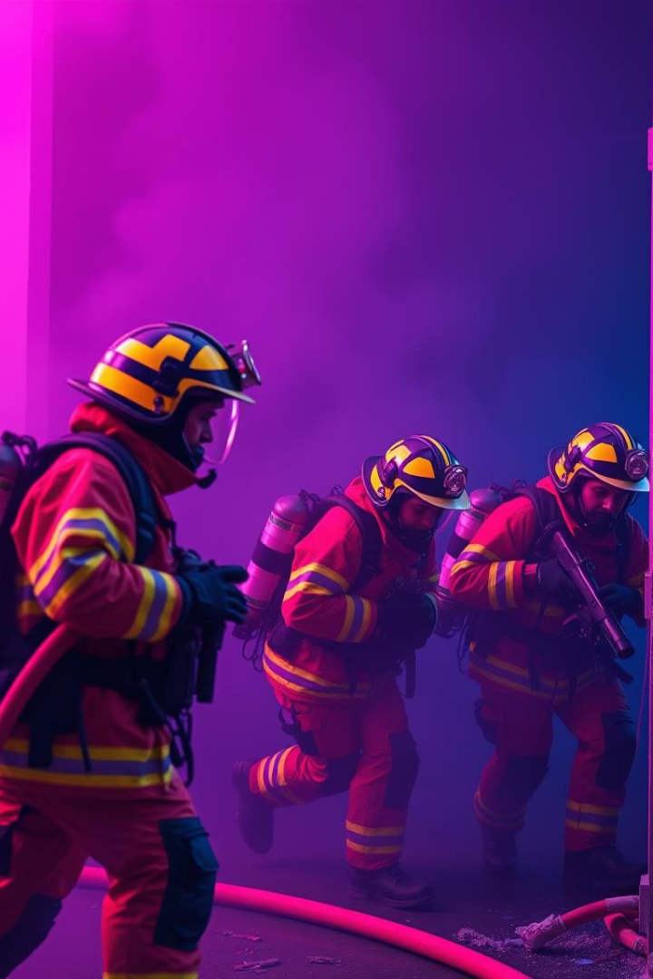




Common ERT Responsibilities
Evacuation Procedures
Fire Suppression
Search & Rescue
Control and extinguish fires to prevent spread.
Locate and rescue trapped or injured individuals.
Guide safe exit and assemble at designated points.
Post-Incident Reporting
Assess and document incident outcomes and lessons learned.

Slide 8




Training and Preparedness
Regular Drills
Specialized Training
1
Practice scenarios to maintain readiness and quick response.
Train for specific hazards such as hazardous materials and disasters.
2
Competency Development
4
Plan Reviews
Ensure team members are confident and skilled in their roles.
3
Update emergency response plans yearly based on best practices.

